Slide 1



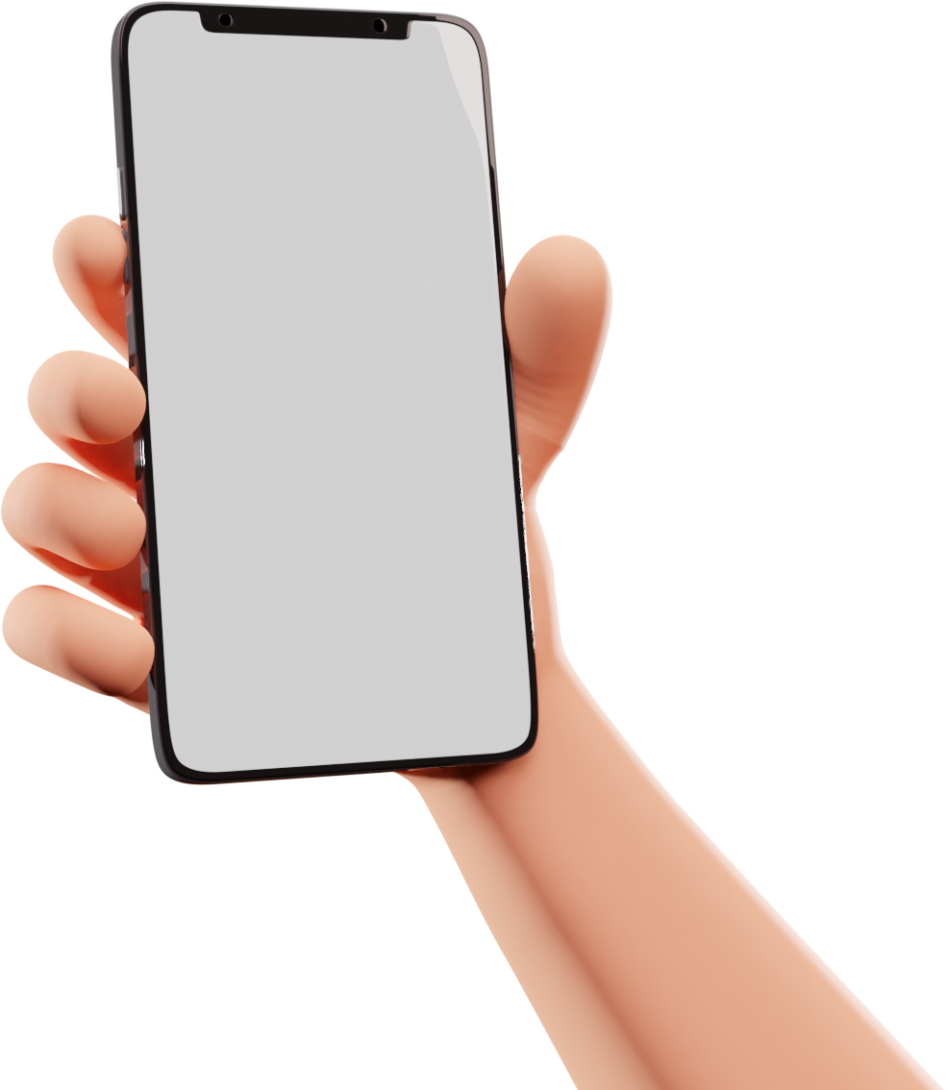
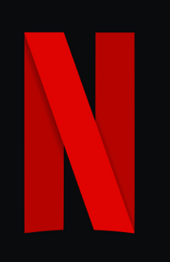
FLIX FUSION
A NETFLIX CLONE
Presented by Pod 31
Codepath AND101

Slide 2
Recycler Views x4 Horizontal
Recycler Views x4 Vertical
FEATURES
Imageview x1
TEAM
Buttons x2
Bottom Navigation Bar
The idea is to learn about Netflix’s design and how it was made to look that cool. Nesting recycler views and connecting APIs to each of the views is the backbone of the front page of Netflix. This project is solely based on curiosity
Toast Messages
Fonts and Styles
App Icons
The experience
Codepath AND101

Slide 3
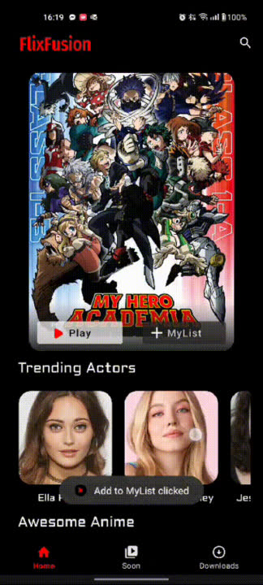

FIRST LOOK
Here’s a demo of the app. It was made to look very similar to that of netflix with 4 API calls
Netflix says nearly half of their viewer base uses Netlfix Mobile
Codepath AND101

Slide 4


TMDB API
The API service is for those interested in using our movie, TV show, or actor images and/or data in your application. Our API is a system we provide for you and your team to programmatically fetch and use our data and/or images
This API needs an API Key
Codepath AND101

Slide 5
THANKS FOR LISTENING
POD 31
KAUSHIK MALIKIREDDY
SYED ARMAN
DANIEL JACKSON
TF
VASANTH BANUMURTHY

